Slide 1

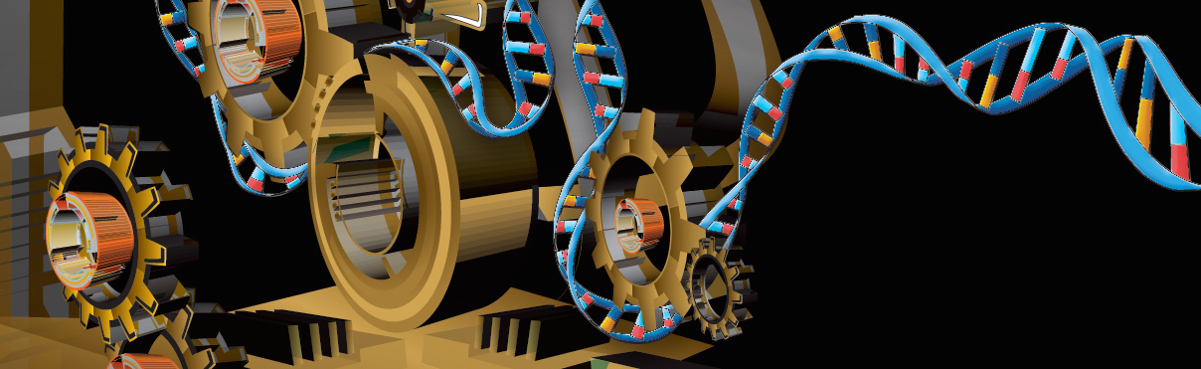
Exploring genome-wide organization of chromatin structure by ChIP-seq
Alon Goren
Assistant Professor
Department of Medicine
Notes:
My lab is focused on studying epigenomic mechanisms and their dynamics in health and disease. We combine tech dev, genomics and basic biology

Slide 2
Outline & Goals
Introduction to chromatin organization
ChIP-seq (Chromatin ImmunoPrecipitation) sequencing
Analysis of the genomic organization of DNA associated proteins
Organization of chromatin regulators
An example study: Cooperative binding of TFs orchestrates reprogramming
Future directions
Goals
Increase comfort in command line environment
Instill good practices – AKA “do not trust anyone, including yourself”

Slide 3
Outline
Introduction to chromatin organization

Slide 4
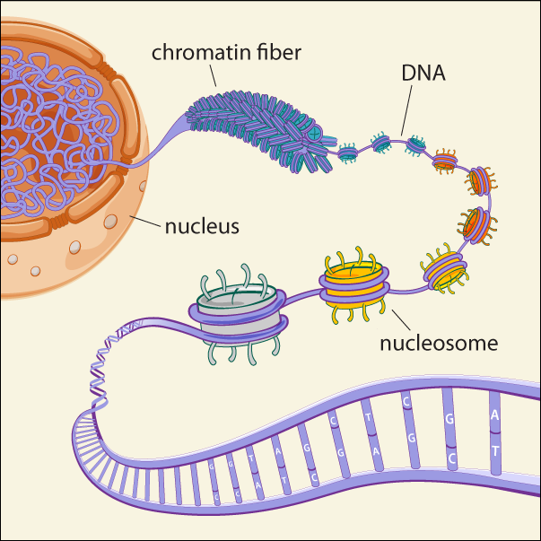
Chromatin Structure & Organization
nucleus
Broad Communications

Slide 5
Chromatin Structure & Organization
Broad Communications

Slide 6
Chromatin Structure & Organization
Broad Communications

Slide 7
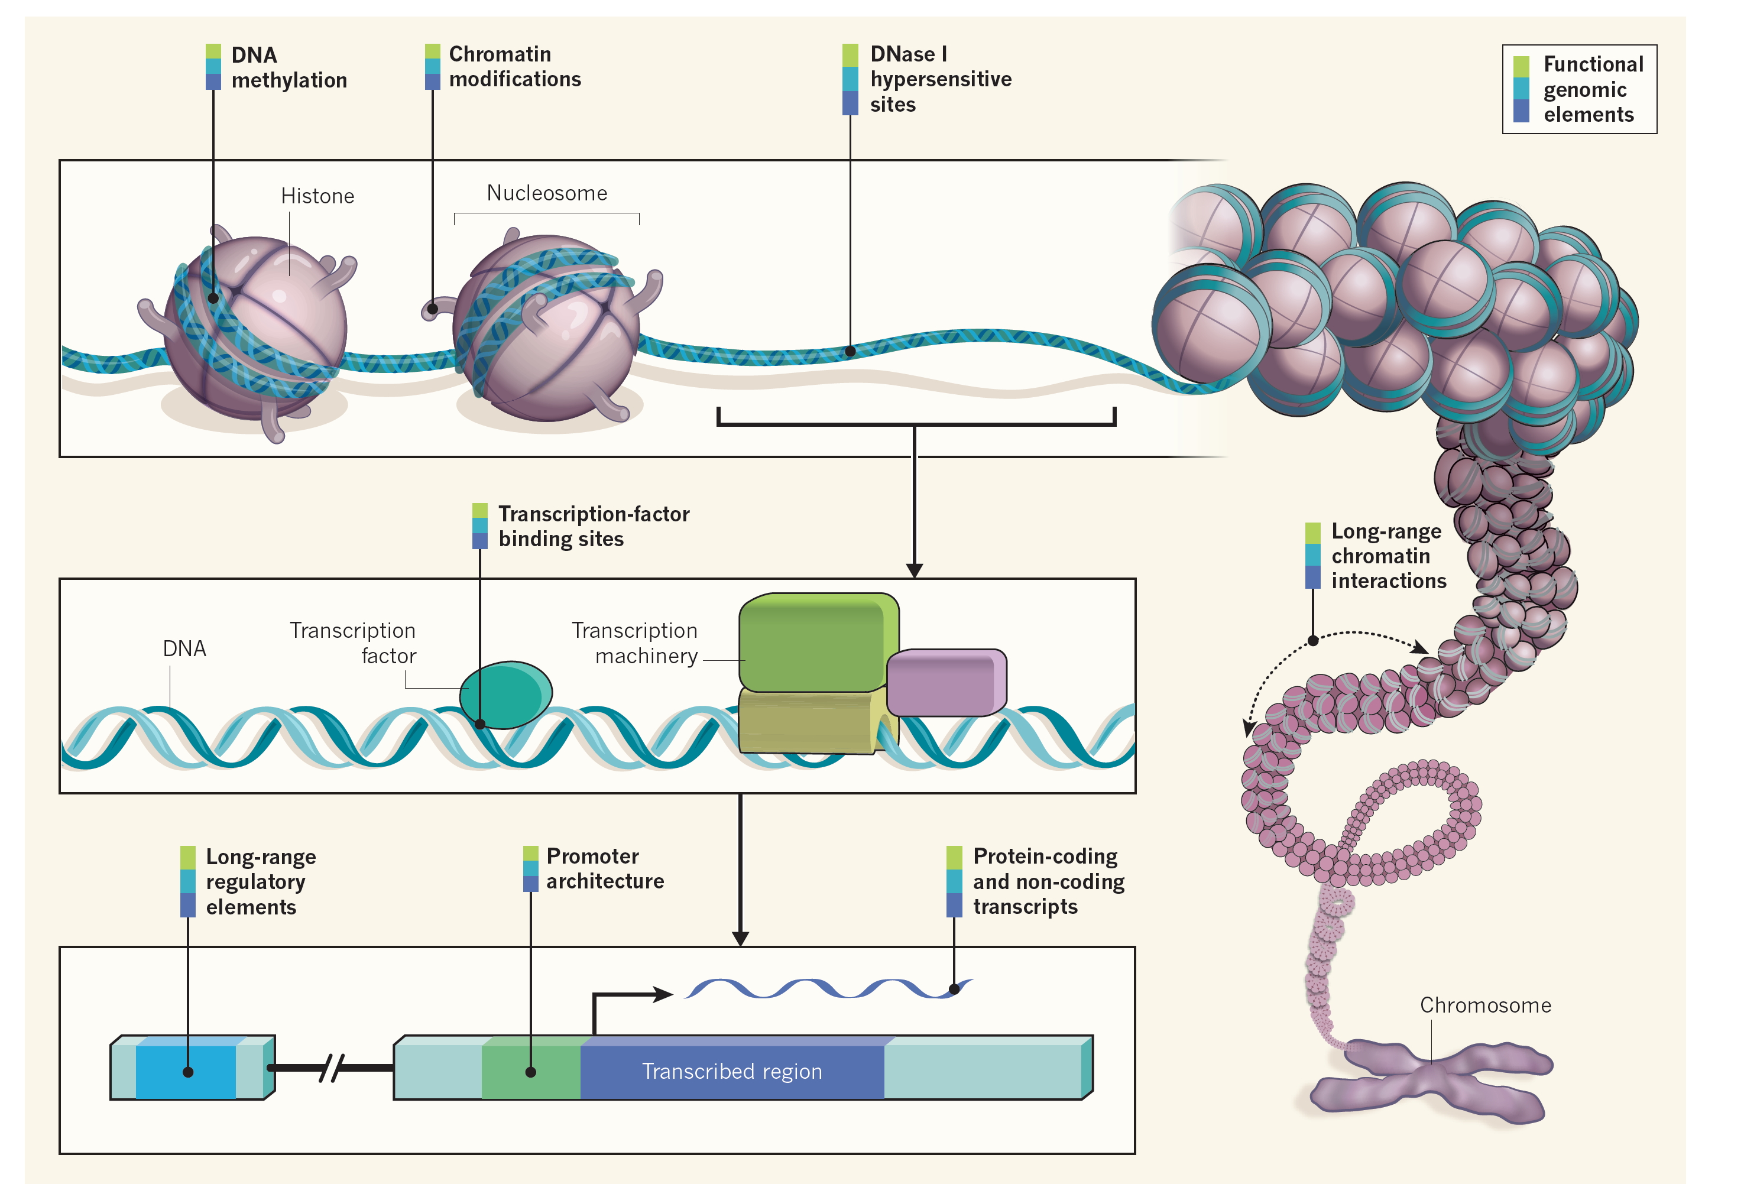
Study of Chromatin Structure & Organization
Ecker et al., Nature 2012

Slide 8
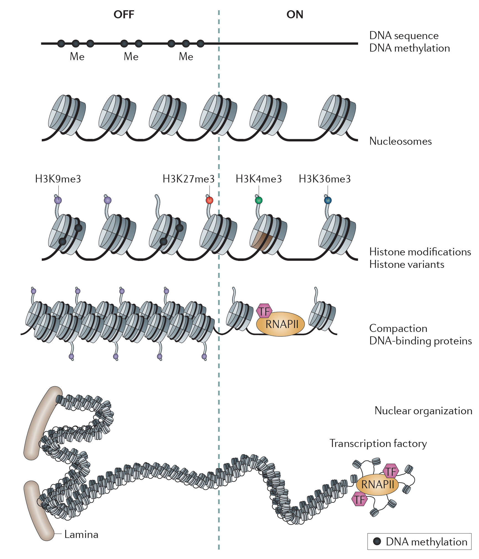
Layers of chromatin organization:
Zhou, Goren & Bernstein Nature Reviews Genetics 2010

Slide 9
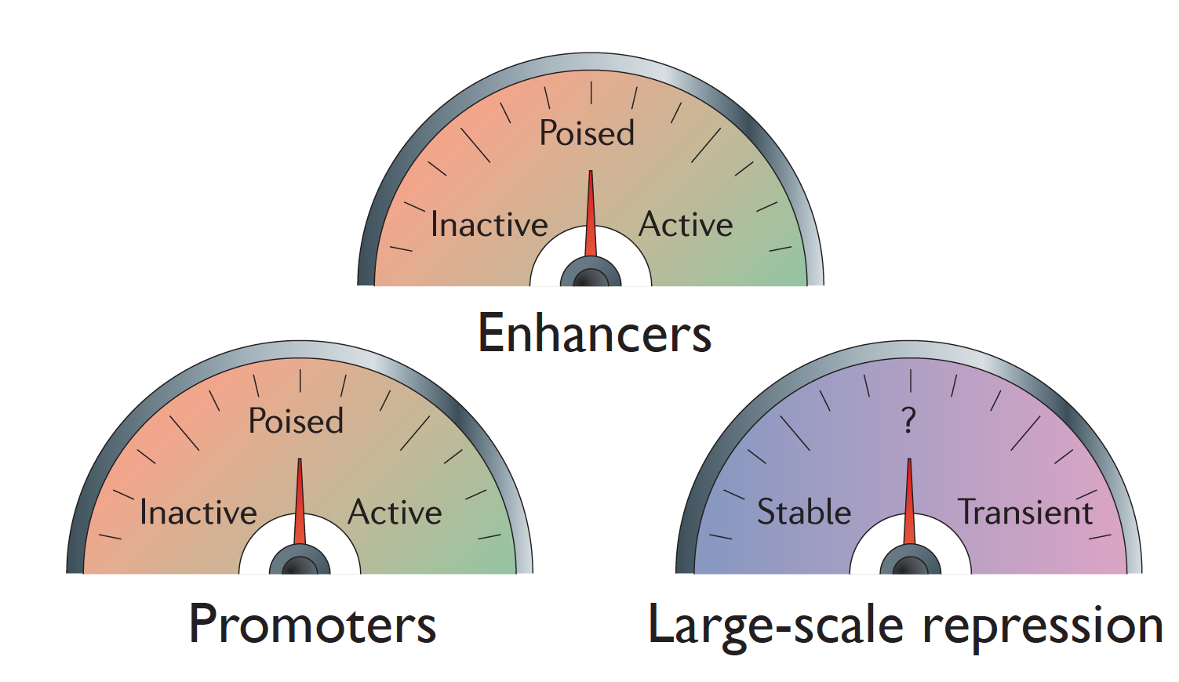
The dynamics of chromatin structure
Modified from Zho, Goren & Bernstein Nature Reviews Genetics 2010

Slide 10
Outline
Introduction to chromatin organization
ChIP-seq (Chromatin ImmunoPrecipitation) sequencing

Slide 11
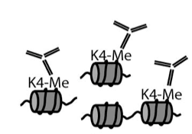
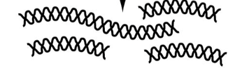
ChIP-seq
Map locations of proteins or protein variants bound to genomic DNA
Whole genome approach: Doesn’t require a priori knowledge
Targeting approach: identifies protein binding locations
Opened up a whole new field of chromatin structure
Immunoprecipitate fragmented chromatin
Purify DNA
Cross-linked cells
Sequence

Slide 12
Analysis of ChIP-seq data
Mikkelsen et al., Nature 2007

Slide 13
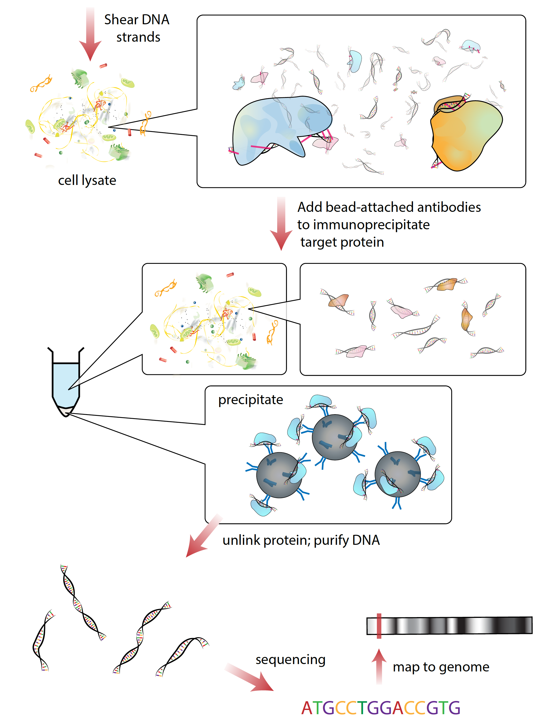
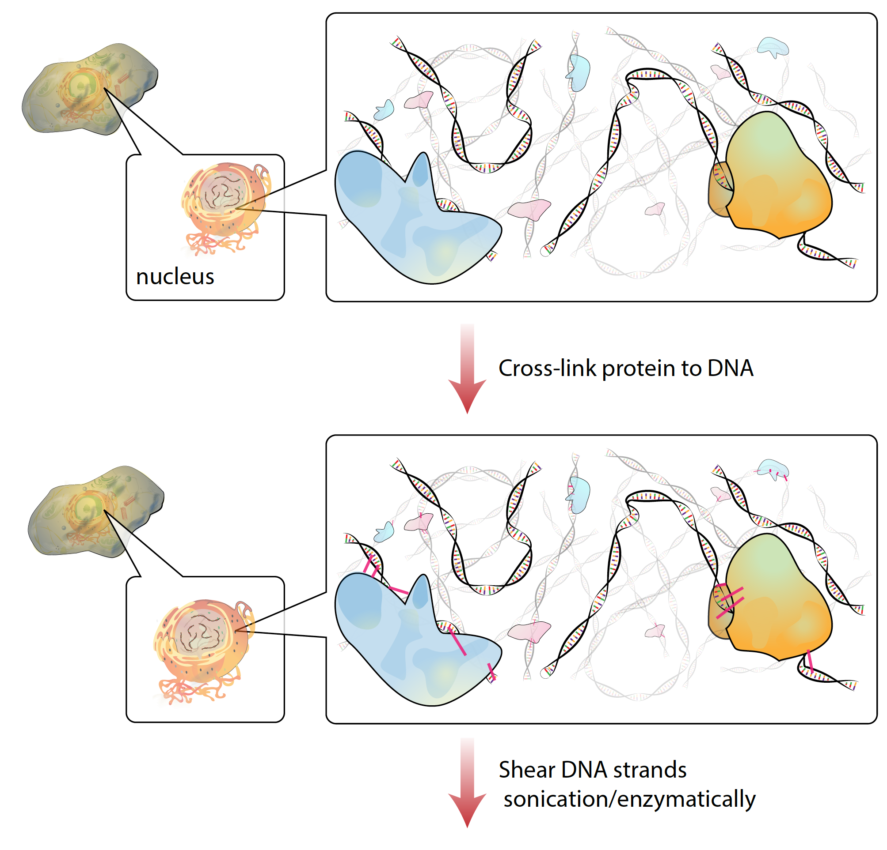
ChIP-seq – chart genomewide chromatin maps
Wikipedia.org

Slide 14

Analysis of ChIP-seq data
http://homer.ucsd.edu/homer/
Heinz & Benner et al., Mol Cell 2010

Slide 15
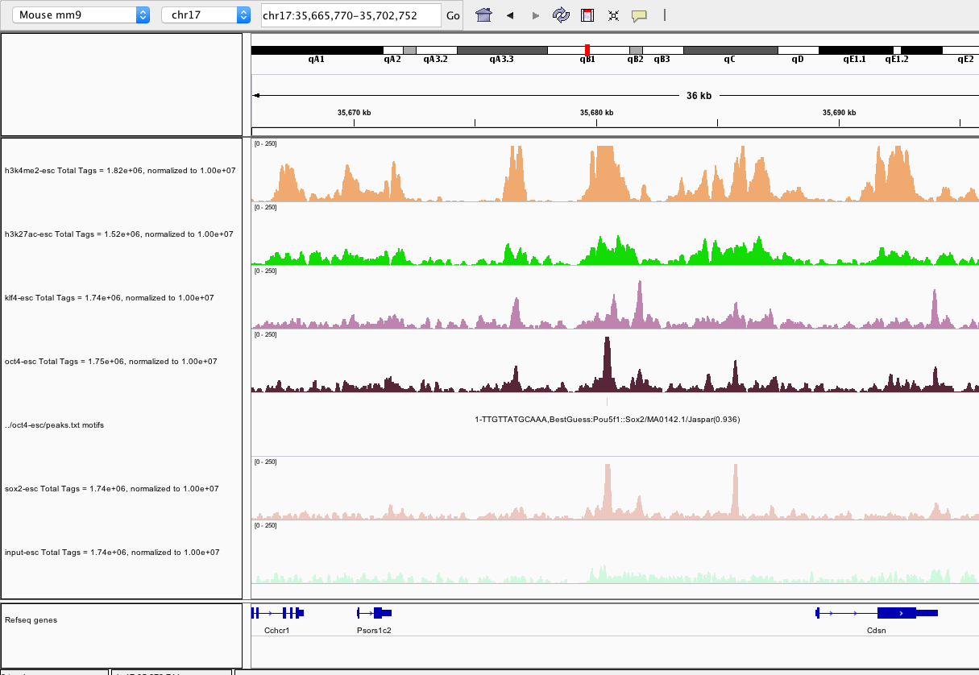
Visualization of ChIP-seq data (IGV)
http://software.broadinstitute.org/software/igv/home

Slide 16
IGV user guide key links
All from: http://software.broadinstitute.org/software/igv/UserGuide
Menu bar: http://software.broadinstitute.org/software/igv/MenuBar
Tool bar: http://software.broadinstitute.org/software/igv/ToolBar
Preferences (pay attention to the normalization option): http://software.broadinstitute.org/software/igv/Preferences
Multi locus view: https://software.broadinstitute.org/software/igv/multilocus_view
IGVTools: http://software.broadinstitute.org/software/igv/igvtools
http://software.broadinstitute.org/software/igv/home

Slide 17


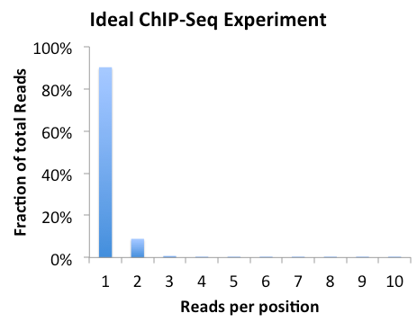
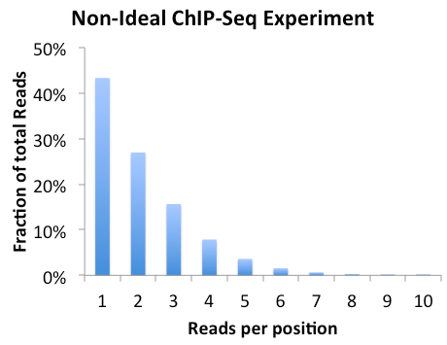
Quality Control: library complexity
Reads from most types of sequencing experiments should not be identical
If an experiment is “clonal”, there is a good chance that not enough starting material was used during library construction/over amplified
http://homer.ucsd.edu/homer/ngs/tagDir.html

Slide 18
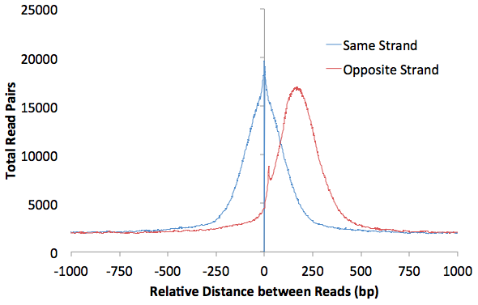
Quality Control: Autocorrelation
36 bp read
Use the distribution between reads to estimate the length of fragments cut-out for sequencing
150 bp ChIP Fragment
http://homer.ucsd.edu/homer/ngs/tagDir.html

Slide 19
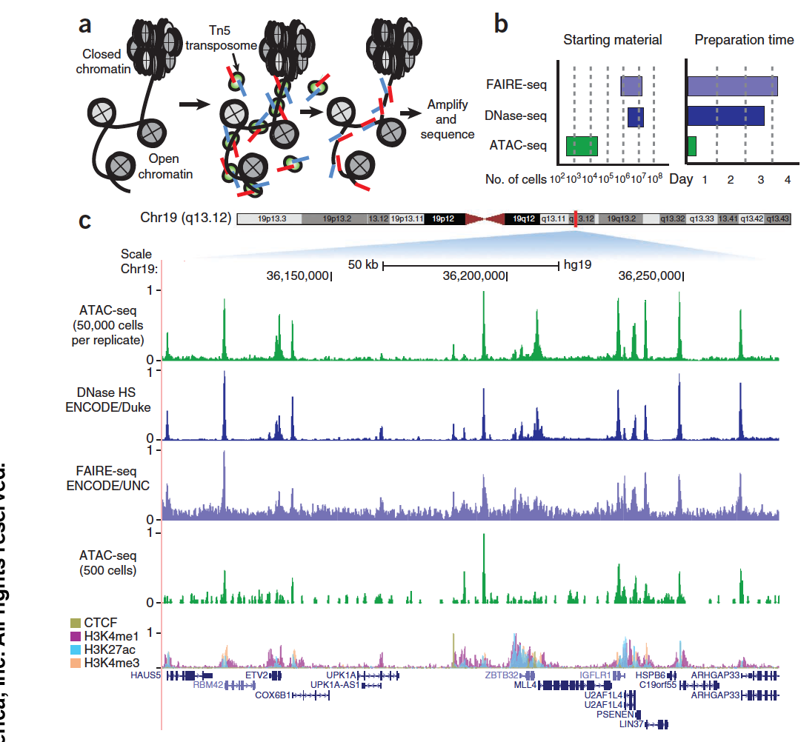
ATAC-seq:
assay for transposase-accessible chromatin
Buenrostro et al., Nature Methods 2013

Slide 20
Outline
Introduction to chromatin organization
ChIP-seq (Chromatin ImmunoPrecipitation) sequencing
Analysis of the genomic organization of DNA associated proteins

Slide 21
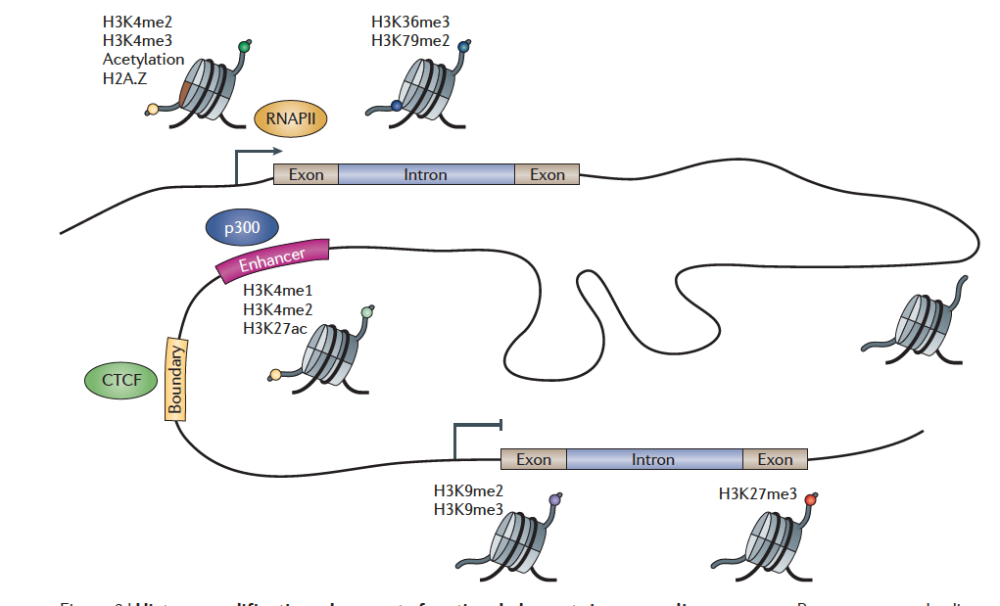
Histone modifications demarcate functional elements
Zhou, Goren & Bernstein Nature Reviews Genetics 2010

Slide 22
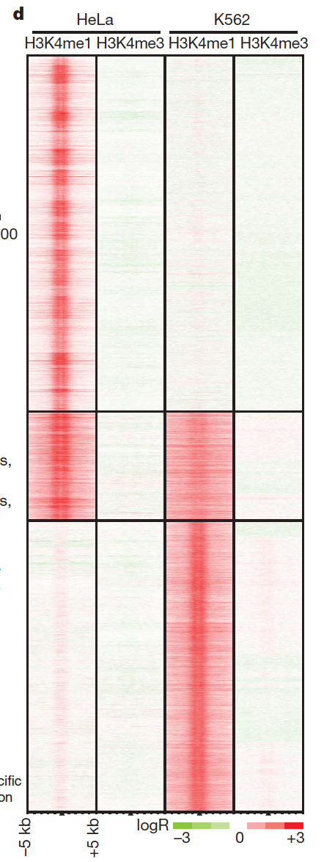
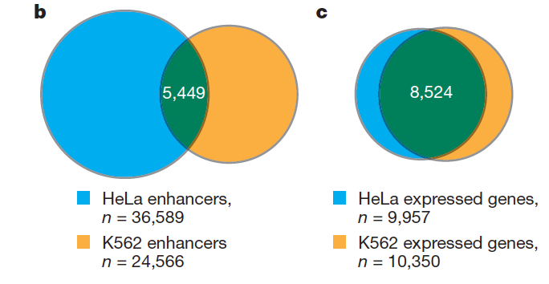
Annotation of putative enhancers
Heintzman, Hon & Hawkins et al., Nature 2009

Slide 23
The organization of histone modifications on genes
H3K4me3
H3K36me3
Beginning
(Promoter)
Gene body
End
A prototypical gene

Slide 24
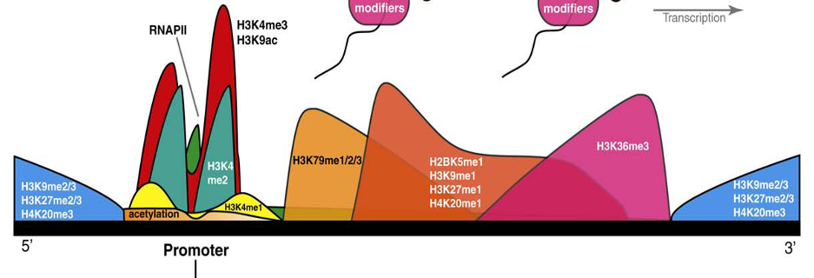
The organization of histone modifications on genes
Beginning
(Promoter)
Gene body
End
Barth et al., Trends in Bio Sci. 2010

Slide 25
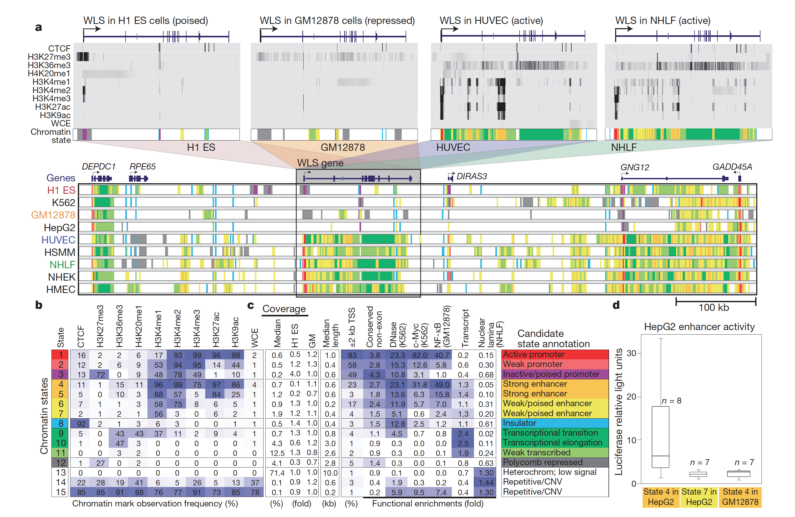
Chromatin States – Discrete Genomic Combinations of HMs
Ernst et al., Nature 2011

Slide 26
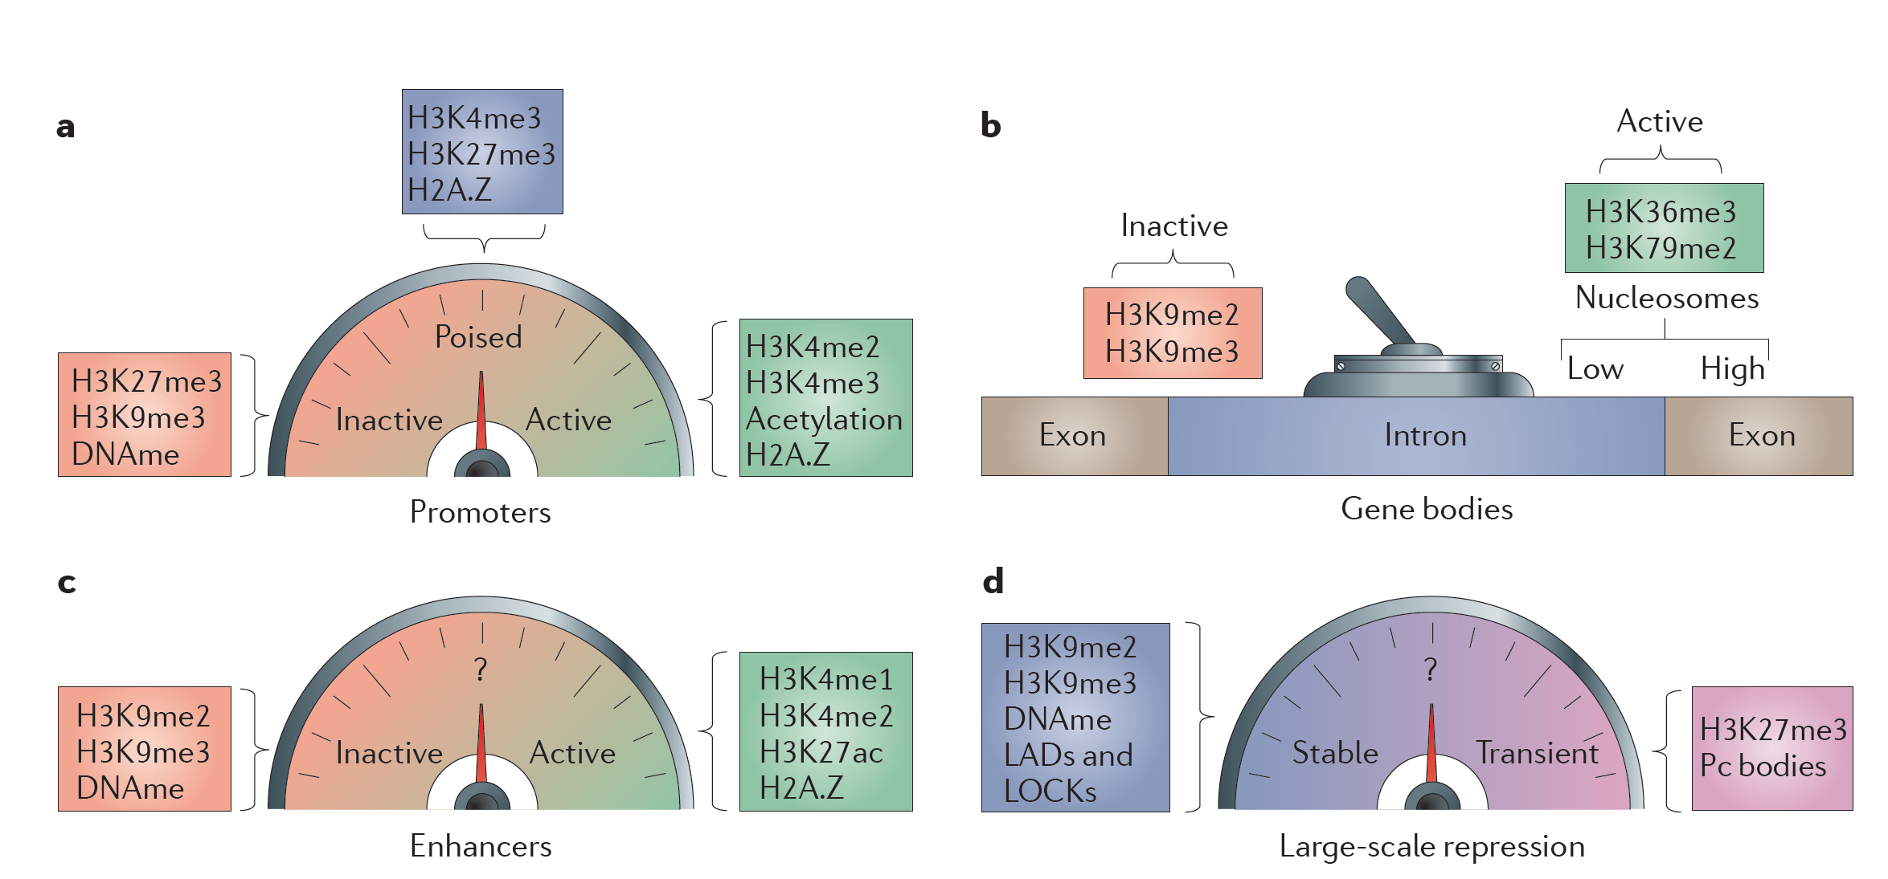
Fine-Tuning of genomic elements by histone modifications
Zhou, Goren & Bernstein Nature Reviews Genetics 2010

Slide 27
Outline
Introduction to chromatin organization
ChIP-seq (Chromatin ImmunoPrecipitation) sequencing
Analysis of the genomic organization of DNA associated proteins
An example study: Cooperative binding of TFs orchestrates reprogramming

Slide 28
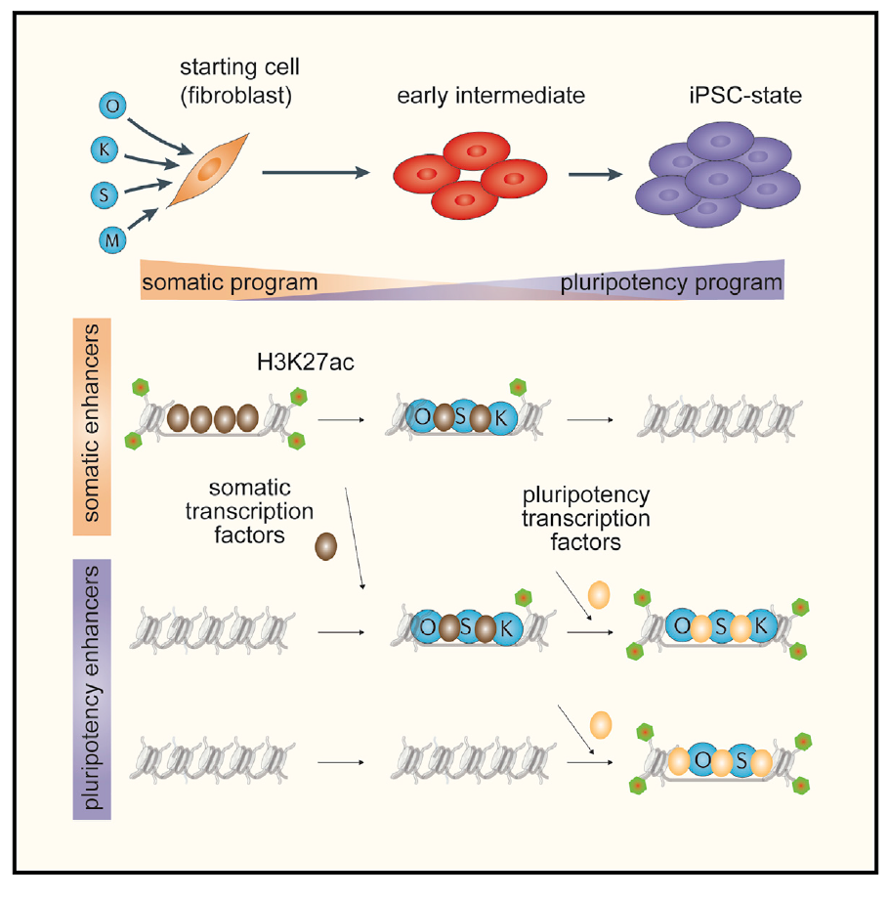
TF binding orchestrates reprograming
Chronis & Fiziev et. al Cell 2017

Slide 29
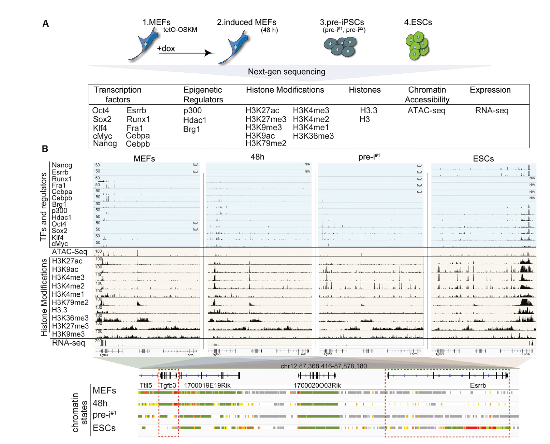
TF Binding during reprograming stages
Chronis & Fiziev et. al Cell 2017

Slide 30
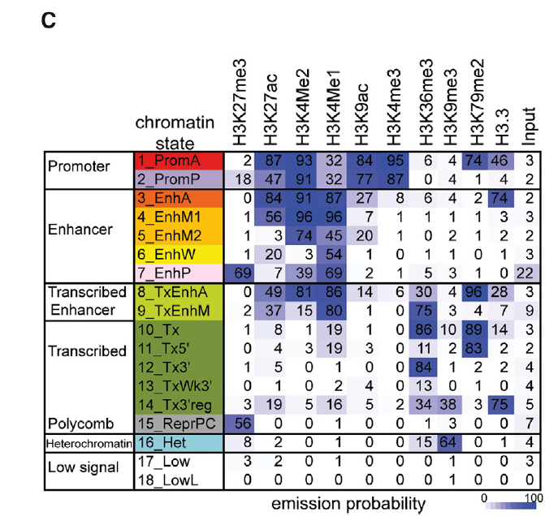
TF Binding during reprograming stages
Chronis & Fiziev et. al Cell 2017

Slide 31
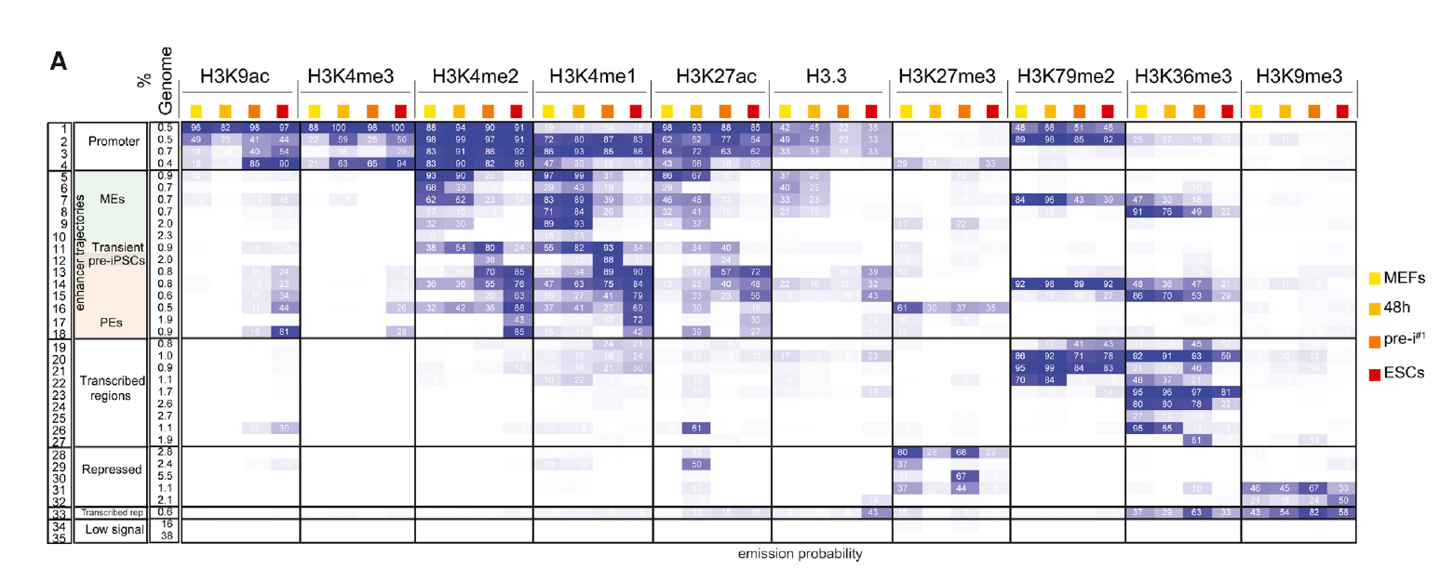
Enhancer reorganization during reprograming stages
Chronis & Fiziev et. al Cell 2017

Slide 32
Outline
Introduction to chromatin organization
ChIP-seq (Chromatin ImmunoPrecipitation) sequencing
Analysis of the genomic organization of DNA associated proteins
An example study: Cooperative binding of TFs orchestrates reprogramming
Future directions

Slide 33
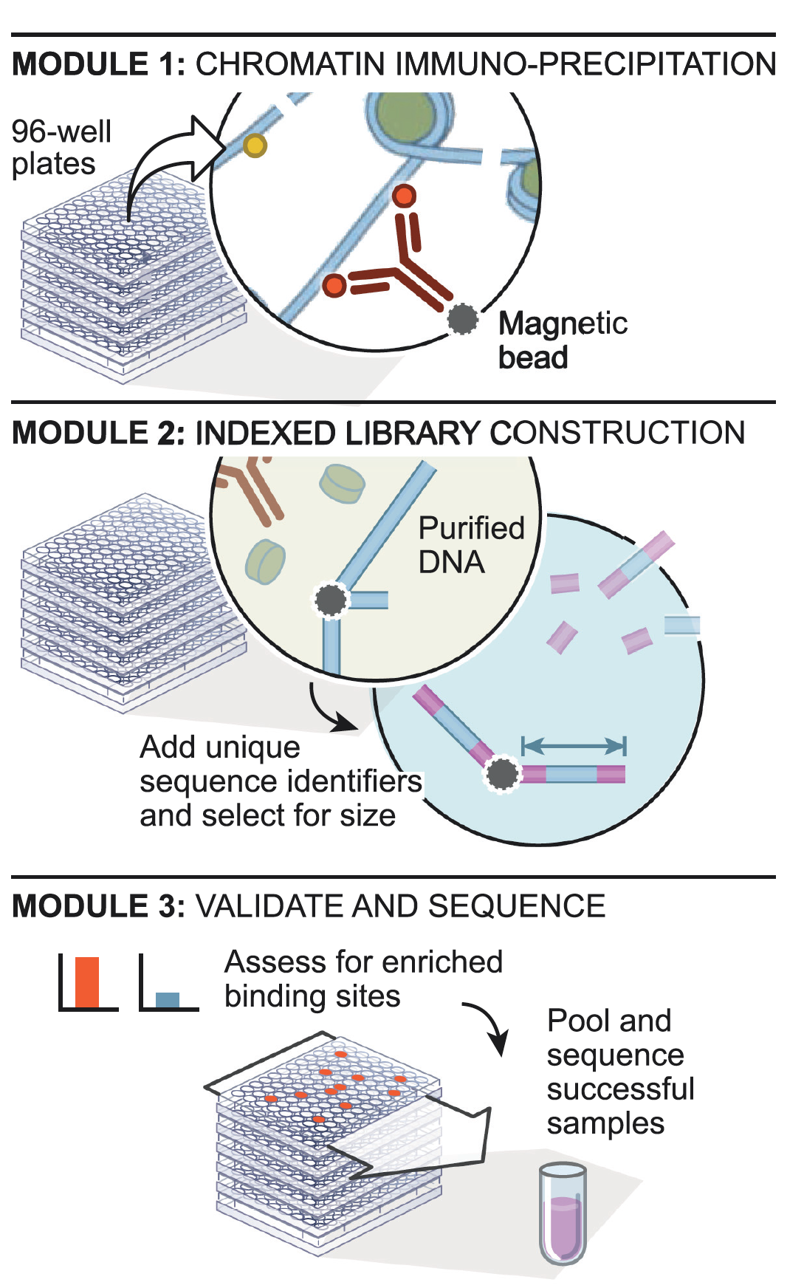
Robust scalable automated ChIP-seq
Garber & Yosef et al Mol Cell 2012

Slide 34
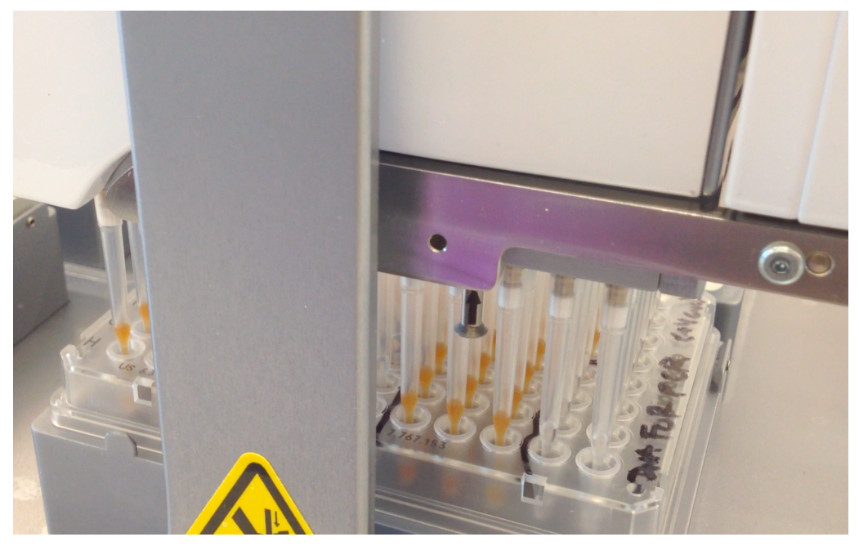
Establishment of robustness via automation

Slide 35
ChIP-seq process
Prep cells
Chromatin ImmunoPrecipitation
Cross-link
(Formaldehyde)
Freeze
pellet
Cells
Lyse
Shear
wash
thaw
Elute
12 washes
Ab bind
incubate
dilute
Library
construction
Prepped Abs
WCE
End repair
A base tail
Ab
QC
Size exclusion
& cleanup
Ligate barcoded adapters
Protein A,G
mag beads
(Sequence)
PCR
amplification
Size exclusion
& cleanup
DNA sequencing
QC (several)
DNA sequencing (several options)
Analysis

Slide 36
ChIP-seq process: Automated
Prep cells
Chromatin ImmunoPrecipitation
Cross-link
(Formaldehyde)
Freeze
pellet
Cells
Lyse
Shear
wash
thaw
Elute
12 washes
Ab bind
incubate
dilute
Library
construction
Prepped Abs
WCE
End repair
A base tail
Ab
QC
Size exclusion
& cleanup
Ligate barcoded adapters
Protein A,G
mag beads
(Sequence)
PCR
amplification
Size exclusion
& cleanup
DNA sequencing
QC (several)
DNA sequencing (several options)
Analysis

Slide 37
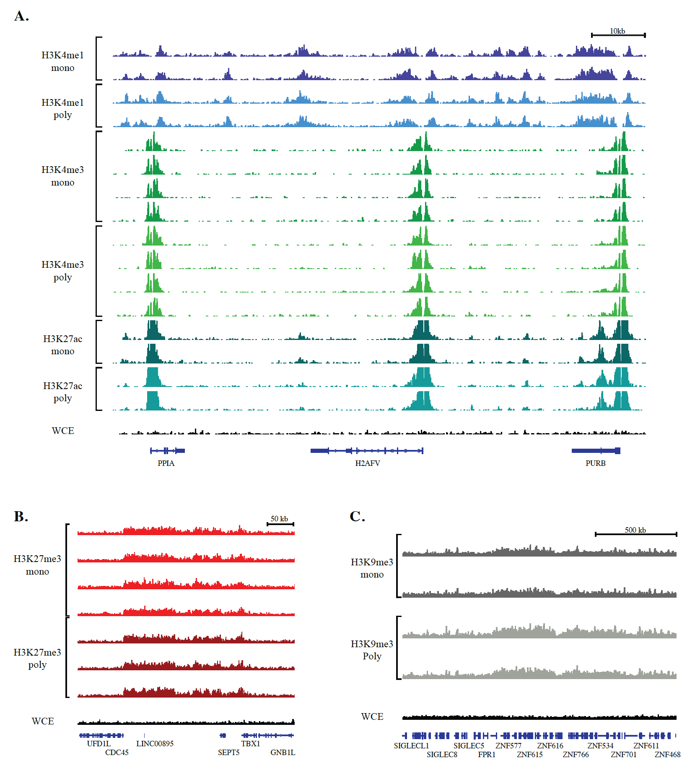
Systematic comparison of monoclonal vs polyclonal antibodies for ChIP-seq
Busby, et. al. Epigenetics & Chromatin, 2016

Slide 38
Prod-seq & Whip-seq

Slide 39
Questions ?

